Slide 1
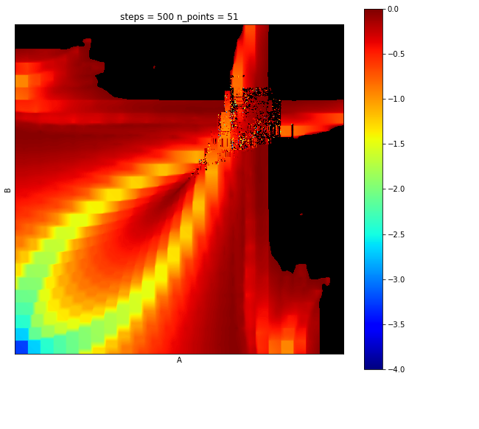
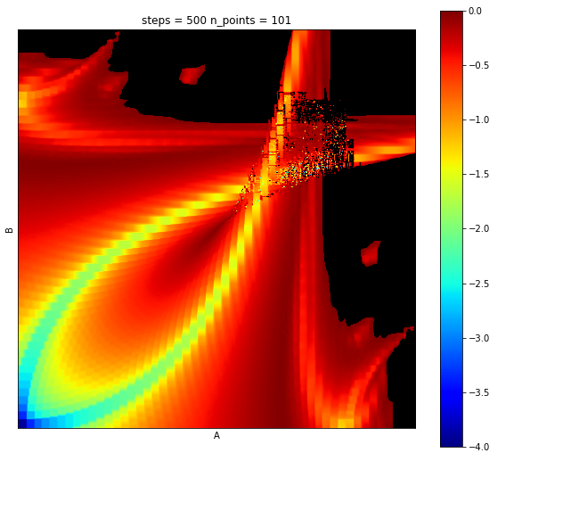

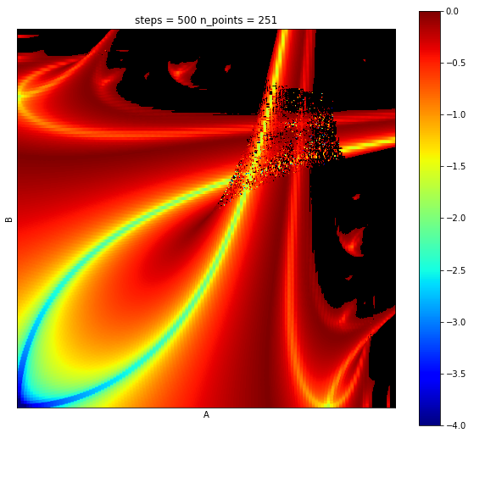
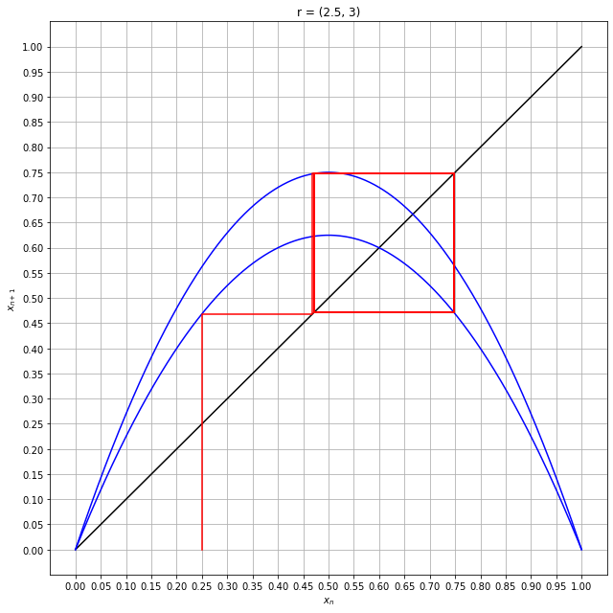
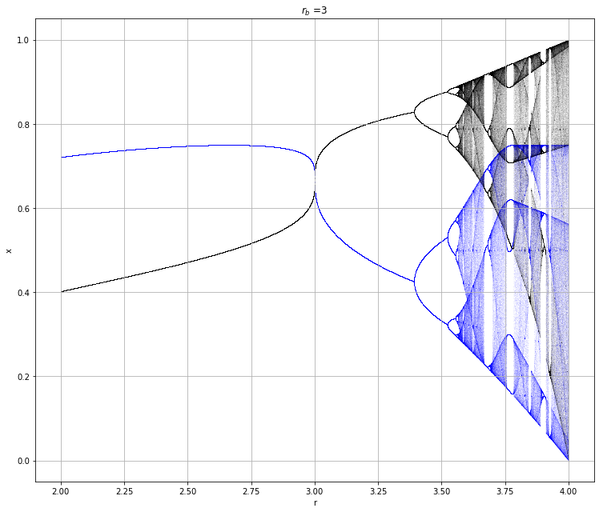
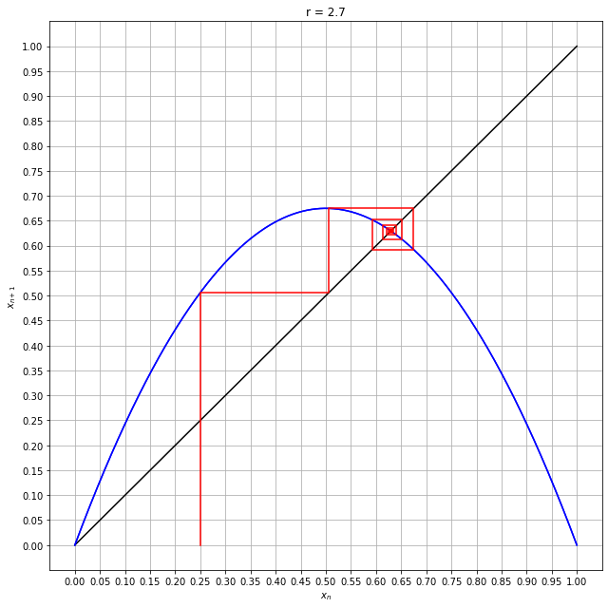
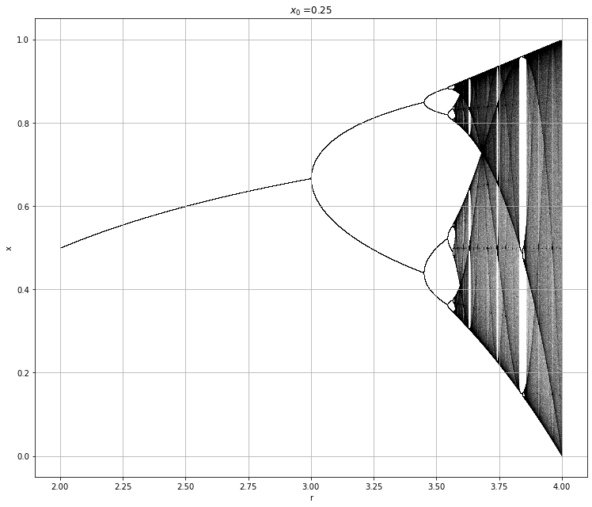
Eric Botti and Dr Ramsey – Invariant Measure Theory and Linear Approximations of Lyapunov Fractals
Abstract
Actuators, sensors, and computational components may be controlled intermittently in time and, thus, inconsistently perform any given operation. The inconsistencies in control operation directly influence the time domain of the control system. Previously, it was shown that chaos can be introduced into a system by changing only the time domain. Previously it was also shown that chaos exists in stochastic time domains in the same system. Can chaos be appropriately predicted by estimating the controlling system via linear approximation and an assumption of invariant weights across the domain? We answer this question in the affirmative. Using this technique, computation of a traditional Lyapunov fractal, SuPeR fractal, or any iterative fractal, no longer involves iterating over the deterministic steps in the time series, but can be estimated by linearly approximating the underlying continuous system using a system of linear equations. We show, via experiment, that in the limit, this estimation is equivalent to the iterative method.

